Slide 1

Corporate Finance Lecture 8.2: Capital Structure: M&M Theorem, Cost of Capital (with tax)
Yuan Shi ©
HSBC Business School
Peking University

Slide 2

Irrelevant?
M&M Theorem: Without friction, capital structure is irrelevant.
What does “No Frictions” mean?
No tax shield (no taxes, or interest is paid after tax)
No consequences of financial distress for assets
No information asymmetry and agency frictions
Individuals can borrow and lend at the same rate as corporations

Slide 3
Taxes
In most countries, interest expense is tax deductible while dividend payouts to shareholders are not.
Partial deduction of interest was introduced in 1894 but overturned by Supreme Court in 1895
Restored from 1909 to 1916 to help the indebted railroad industry
Full deductibility of interest was eventually permitted in 1918 as part of a package to help companies struggling with the effects of the first world war

Slide 4
Taxes
By replacing some equity with debt, a firm would pay more in interest (less in dividend), but less in tax payments.
The total cash flows to equity and debt holders are larger by the amount of tax saving.
So, the value of a levered company is greater than that of a unlevered firm.
Notice that we are assuming taxes only affect the distribution of cash flows, but not the FCF per se generated from the firm’s continuing operations.

Slide 5
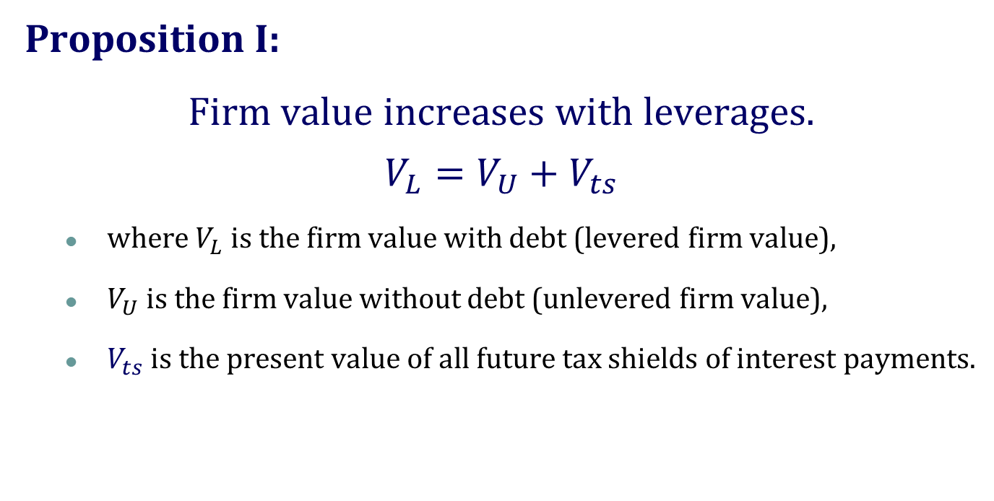
The M&M Theorem with Taxes
Proposition I:
Firm value increases with leverages.
$$V_{L}=V_{U}+V_{ts}$$
where $V_{L}$ is the firm value with debt (levered firm value),
$V_{U}$ is the firm value without debt (unlevered firm value),
$V_{ts}$ is the present value of all future tax shields of interest payments.

Slide 6
JELLYBEANS, INC.
Assume that there was a tax of 40%
 | Current | Proposed
EBIT | $1,083,000 | $1,083,000
Interest | $0 | $250,000
EBT | $1,083,000 | $833,000
Tax (40%) | $433,000 | $333,000
Net income | $650,000 | $500,000
Total cash flow to shareholders and debtholders | $650,000 | $750,000

Slide 7
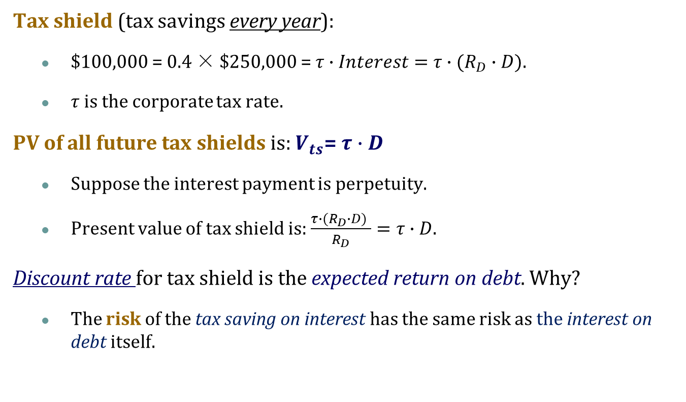
Tax Shield
Tax shield (tax savings every year):
$100,000 = 0.4 × $250,000 = $τ∙Interest=$ $τ∙(R_{D}∙D)$.
$τ$is the corporate tax rate.
PV of all future tax shields is: $V_{ts}$= $τ∙D$
Suppose the interest payment is perpetuity.
Present value of tax shield is: $\frac{τ∙(R_{D}∙D) }{R_{D}}=τ∙D$.
Discount rate for tax shield is the expected return on debt. Why?
The risk of the tax saving on interest has the same risk as the interest on debt itself.

Slide 8



Cash Flows to Equity Holders
With taxes
0 1 2 … infinity
650-250+100 650-250+100 …
$V_{U}$ = $5m
Who claim the tax shield?
The Debt or Equity Holders?
D= $\frac{250,000}{0.1}$=$2.5m
$V_{ts}$= $2.5m ×0.4=$1m

Slide 9
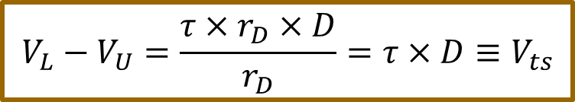
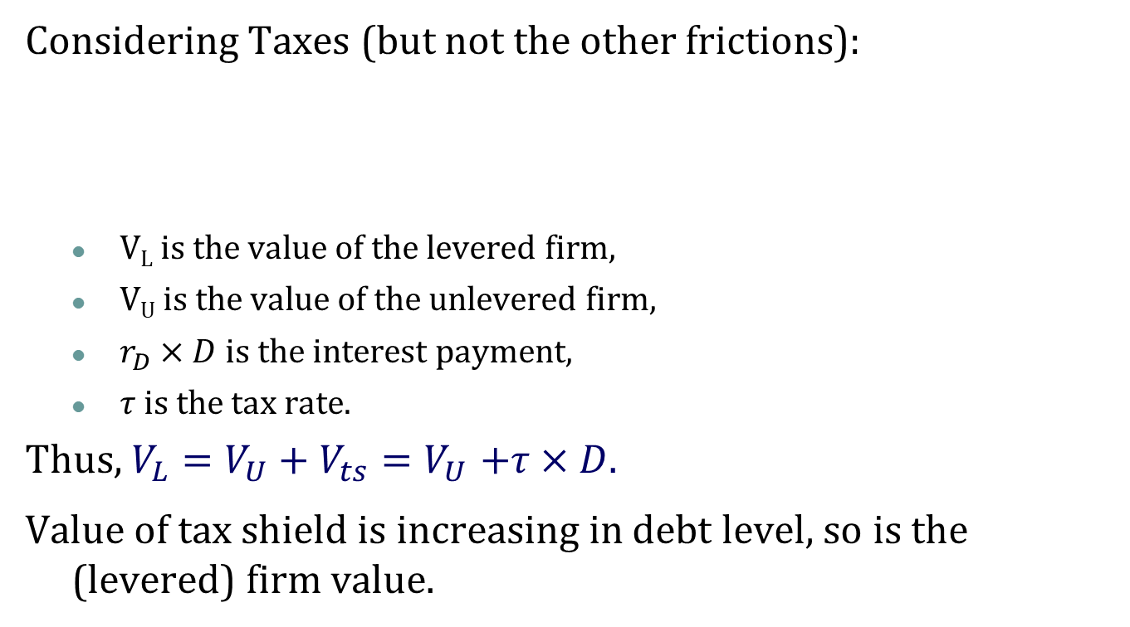
Adjusted Present Value
Considering Taxes (but not the other frictions):
V_{L} is the value of the levered firm,
V_{U} is the value of the unlevered firm,
$r_{D}×D$ is the interest payment,
$τ$ is the tax rate.
Thus, $V_{L}=V_{U}+V_{ts}{=V}_{U}+τ×D$.
Value of tax shield is increasing in debt level, so is the (levered) firm value.
$$V_{L}−V_{U}=\frac{τ×r_{D}×D}{r_{D}}=τ×D≡V_{ts}$$

Slide 10
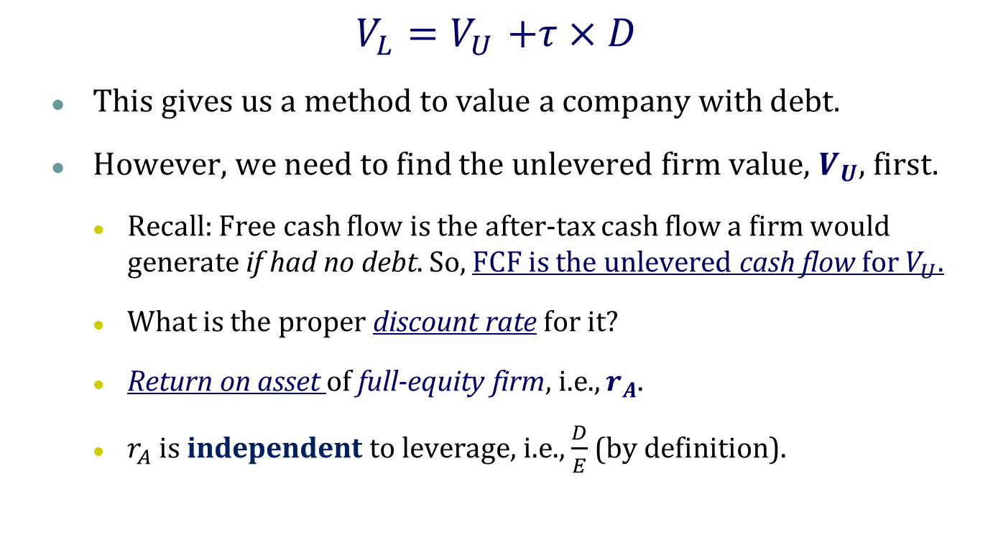
Adjusted Present Value
$$V_{L}{=V}_{U}+τ×D$$
This gives us a method to value a company with debt.
However, we need to find the unlevered firm value, $V_{U}$, first.
Recall: Free cash flow is the after-tax cash flow a firm would generate if had no debt. So, FCF is the unlevered cash flow for $V_{U}$.
What is the proper discount rate for it?
Return on asset of full-equity firm, i.e., $r_{A}$.
$r_{A}$ is independent to leverage, i.e., $\frac{D}{E}$ (by definition).

Slide 11
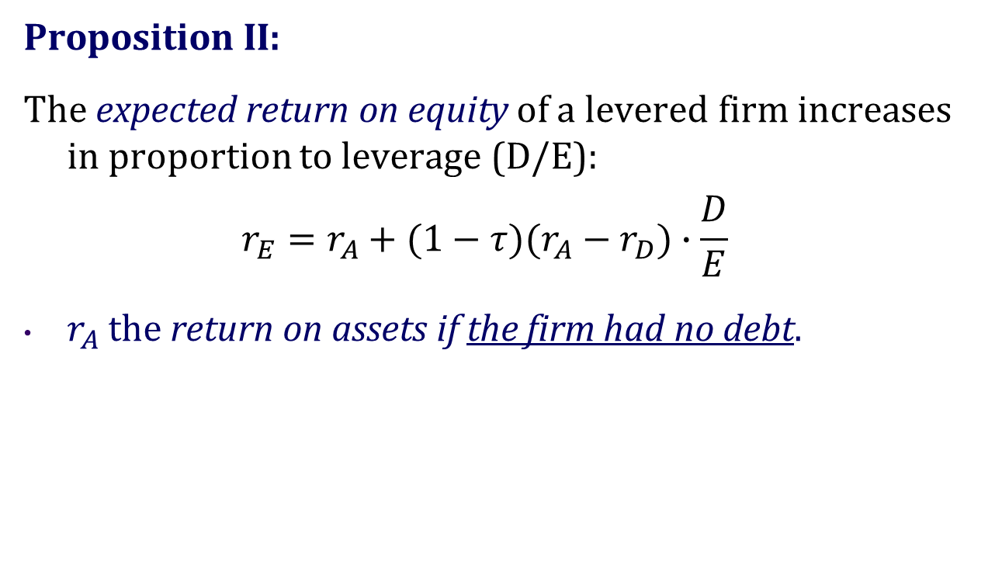
The M&M Theorem with Taxes
Proposition II:
The expected return on equity of a levered firm increases in proportion to leverage (D/E):
$$r_{E}=r_{A}+(1−τ)(r_{A}−r_{D})∙\frac{D}{E}$$
$r_{A}$ the return on assets if the firm had no debt.

Slide 12
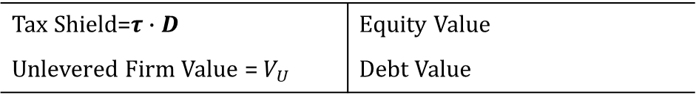
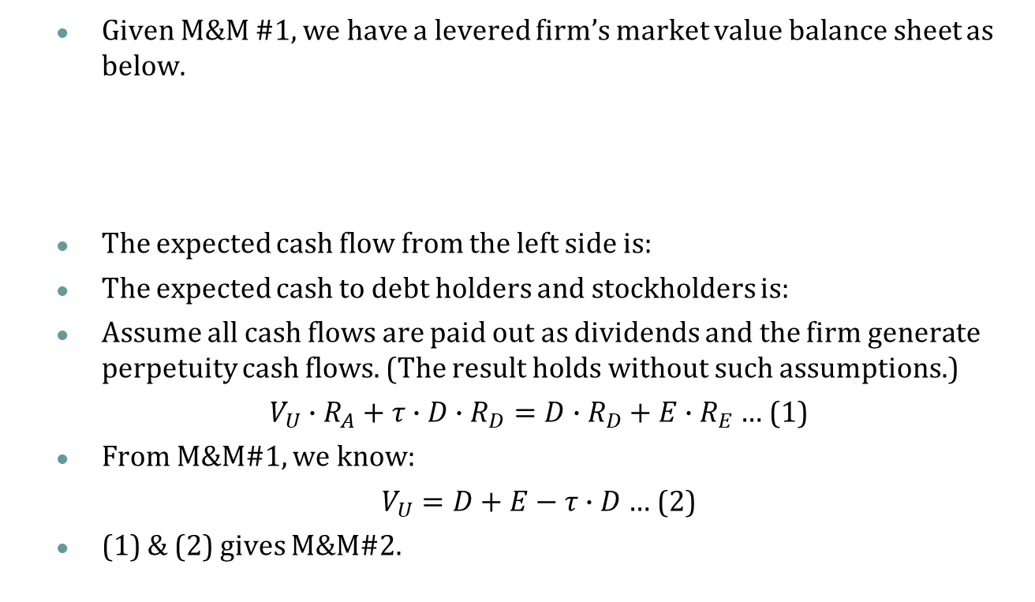


M&M #2 With Taxes (Optional)
Given M&M #1, we have a levered firm’s market value balance sheet as below.
The expected cash flow from the left side is:
The expected cash to debt holders and stockholders is:
Assume all cash flows are paid out as dividends and the firm generate perpetuity cash flows. (The result holds without such assumptions.)
$V_{U}∙R_{A}+τ∙D∙R_{D}=D∙R_{D}+E∙R_{E}$ … (1)
From M&M#1, we know:
$V_{U}=D+E−τ∙D$ … (2)
(1) & (2) gives M&M#2.
Tax Shield=$τ∙D$ | Equity Value
Unlevered Firm Value = $V_{U}$ | Debt Value
$$V_{U}∙R_{A}+τ∙D∙R_{D}$$
$$D∙R_{D}+E∙R_{E}$$

Slide 13
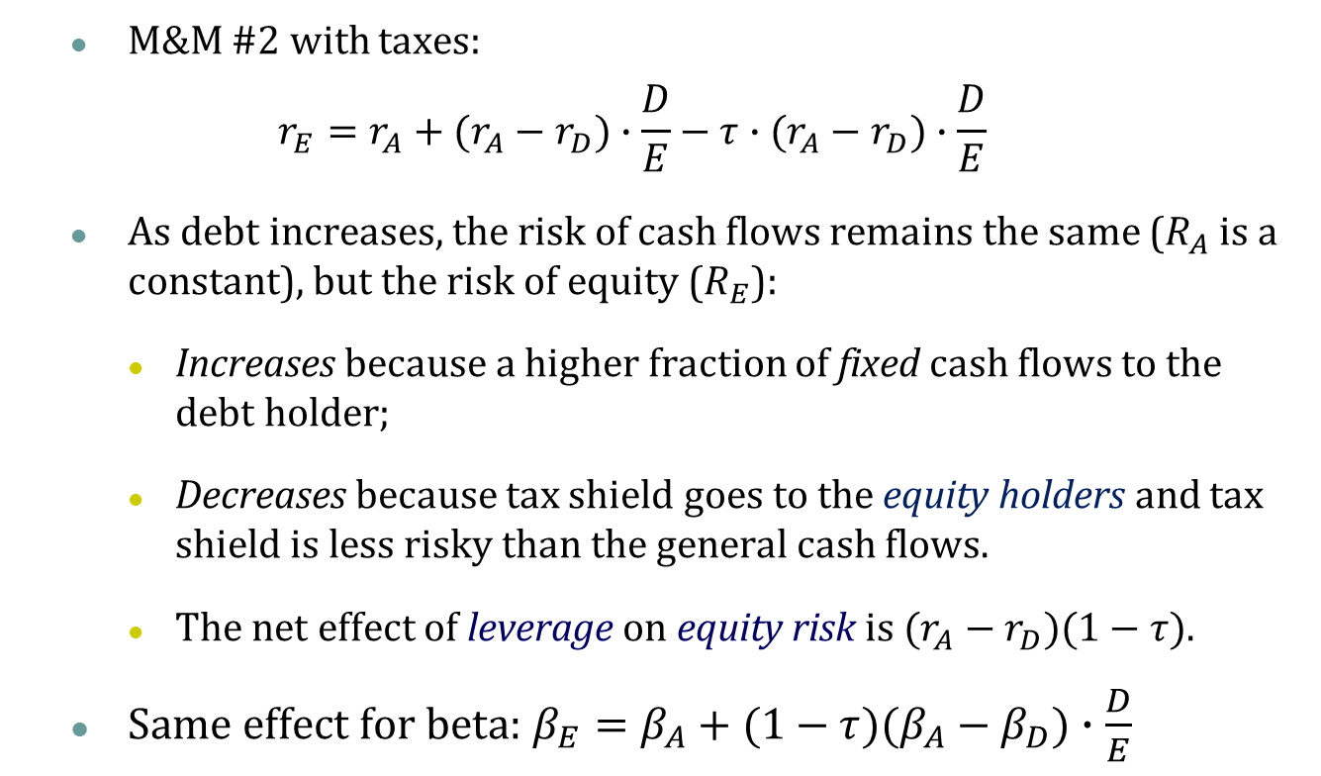
The Effect of Financial Leverage
M&M #2 with taxes:
$$r_{E}=r_{A}+(r_{A}−r_{D})∙\frac{D}{E}−τ∙(r_{A}−r_{D})∙\frac{D}{E}$$
As debt increases, the risk of cash flows remains the same ($R_{A}$ is a constant), but the risk of equity ($R_{E}$):
Increases because a higher fraction of fixed cash flows to the debt holder;
Decreases because tax shield goes to the equity holders and tax shield is less risky than the general cash flows.
The net effect of leverage on equity risk is $(r_{A}−r_{D})(1−τ)$.
Same effect for beta: $β_{E}=β_{A}+(1−τ)(β_{A}−β_{D})∙\frac{D}{E}$

Slide 14





The Effect of Financial Leverage
Other than tax shield, there are no other frictions
No consequences of financial distress for assets; No information asymmetry and agency frictions; Well functioning financial markets.
Cost of Capital
$$R_{E}=R_{A}+\frac{D}{E}(R_{A}−R_{D})$$
No Tax
$$R_{E}=R_{A}+\frac{D}{E}(1−τ)(R_{A}−R_{D})$$
With Tax
$$R_{A}$$
$$R_{A}$$
$$R_{D}$$
D/E

Slide 15
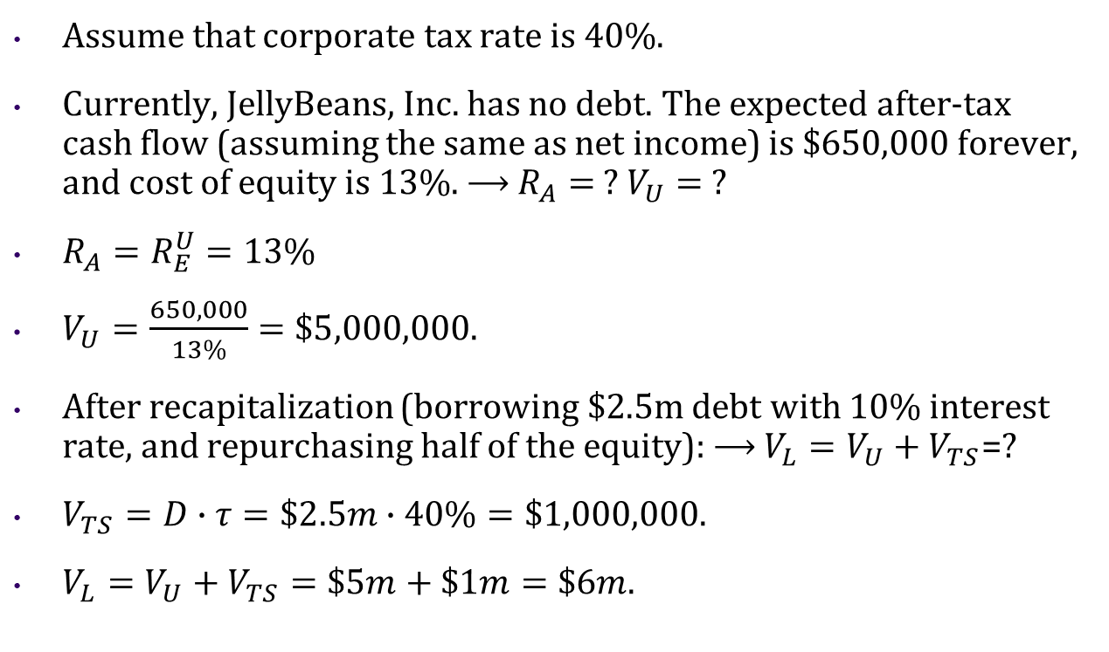
JELLYBEANS, INC.
Try it!
Assume that corporate tax rate is 40%.
Currently, JellyBeans, Inc. has no debt. The expected after-tax cash flow (assuming the same as net income) is $650,000 forever, and cost of equity is 13%. ⟶ $R_{A}=$ ? $V_{U}=$ ?
$R_{A}=R_{E}^{U}=13\%$
$V_{U}=\frac{650,000}{13\%}=\$5,000,000$.
After recapitalization (borrowing $2.5m debt with 10% interest rate, and repurchasing half of the equity): ⟶ $V_{L}=V_{U}+V_{TS}$=?
$V_{TS}=D∙τ=\$2.5m∙40\%=\$1,000,000$.
$V_{L}=V_{U}+V_{TS}=\$5m+\$1m=\$6m$.
Notes:
Regard CF = earnings

Slide 16
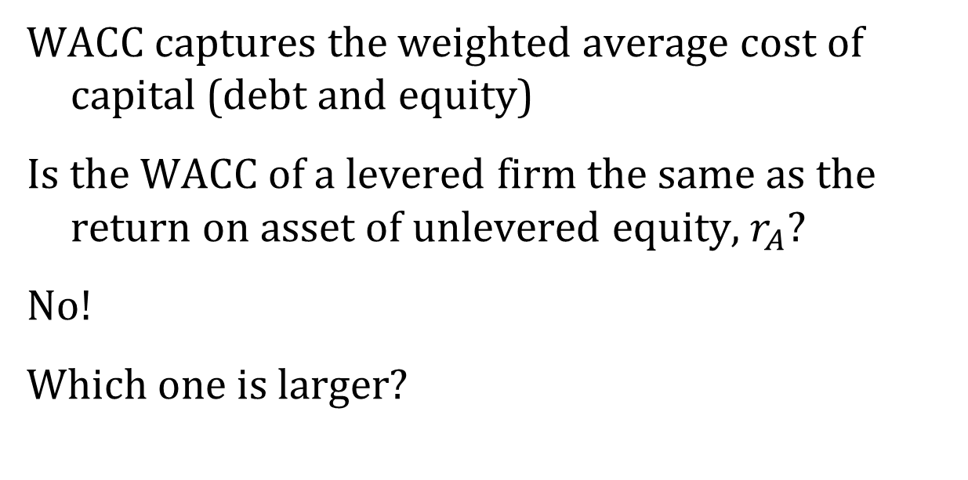
WACC Revisited
Try it!
WACC captures the weighted average cost of capital (debt and equity)
Is the WACC of a levered firm the same as the return on asset of unlevered equity, $r_{A}$?
No!
Which one is larger?
Notes:
Intuitively, Ra > WACC, since Ra=WACC(D=0), and D comes with the tax shield.

Slide 17
JELLYBEANS, INC.
Assume that there was a tax of 40%
What is the WACC with Tax?
 | Current | Proposed
EBIT | $1,083,000 | $1,083,000
Interest | $0 | $250,000
EBT | $1,083,000 | $833,000
Tax (40%) | $433,000 | $333,000
Net income | $650,000 | $500,000
Total cash flow to shareholders and debtholders | $650,000 | $750,000

Slide 18
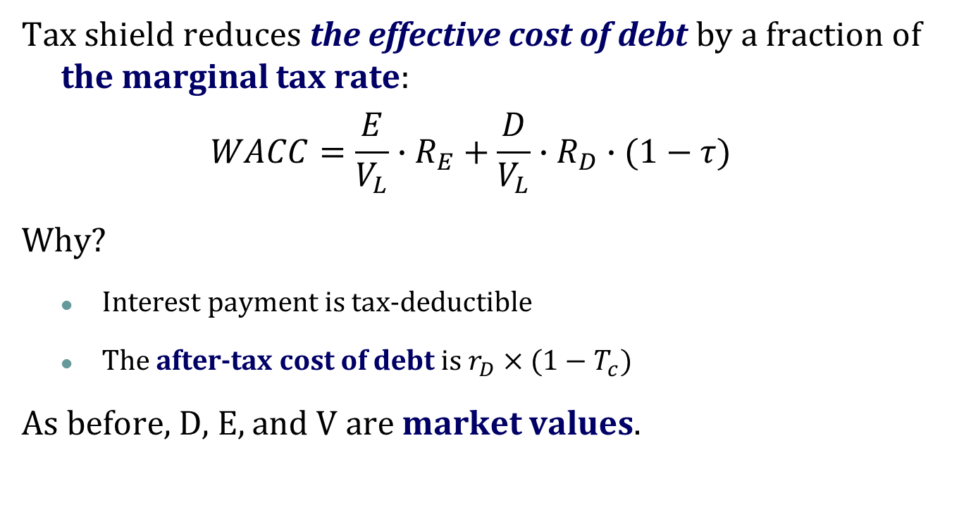
Review: WACC with Taxes
Tax shield reduces the effective cost of debt by a fraction of the marginal tax rate:
$$WACC=\frac{E}{V_{L}}∙R_{E}+\frac{D}{V_{L}}∙R_{D}∙(1−τ)$$
Why?
Interest payment is tax-deductible
The after-tax cost of debt is $r_{D}×(1−T_{c})$
As before, D, E, and V are market values.

Slide 19
Effective After-Tax Cost of Debt
Try it!
Cash Flow generated by Firm Assets
Our World |  | A Parallel World
EBIT | $1,083,000 | EBIT | $1,083,000
Interest | $250,000 | Tax (40%) | $433,000
EBT | $833,000 | EBI | $650,000
Tax (40%) | $333,000 | Interest
Net income | $500,000 | Net income | $500,000
Interest Rate | 10% | Interest Rate
$150,000
6%
Cash Flow entitled to Equity Holders
6%=150,000/2.5m
=10%*(1-0.4)

Slide 20
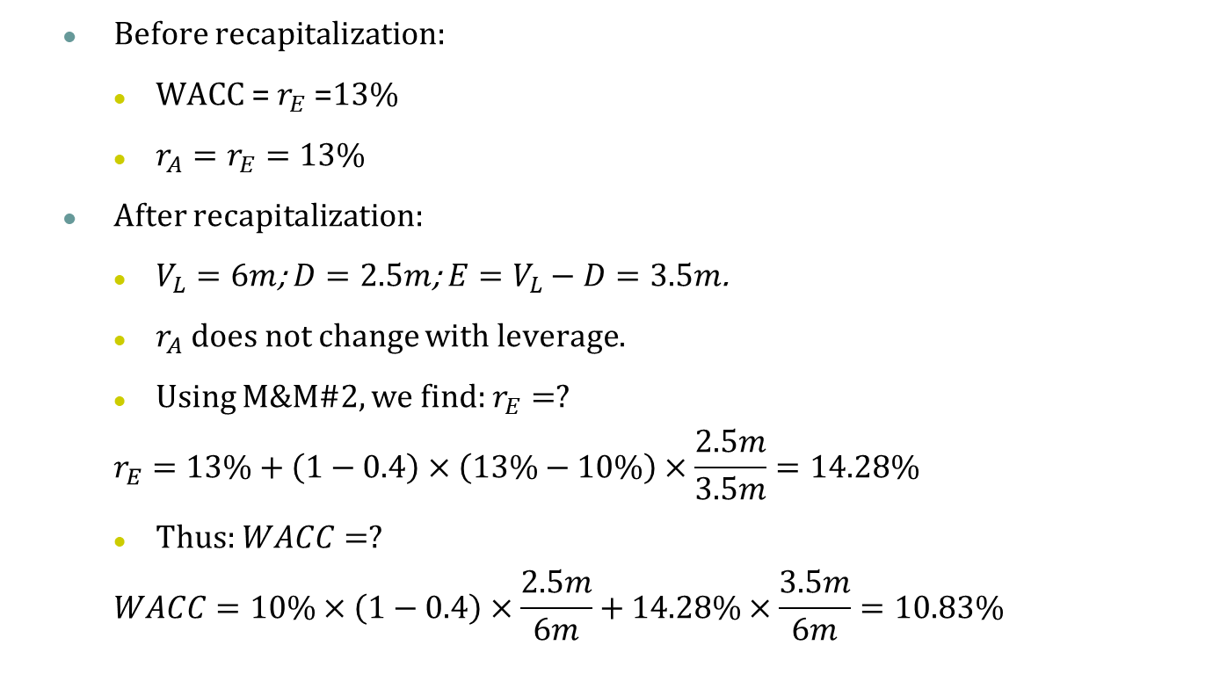
JELLYBEANS, INC.
Try it!
Before recapitalization:
WACC = $r_{E}$ =13%
$r_{A}=r_{E}=13\%$
After recapitalization:
$V_{L}=6m$; $D=2.5m$; $E=V_{L}−D=3.5m$.
$r_{A}$ does not change with leverage.
Using M&M#2, we find: $r_{E}=?$
$$r_{E}=13\%+\left(1−0.4\right)×\left(13\%−10\%\right)×\frac{2.5m}{3.5m}=14.28\%$$
Thus: $WACC=?$
$$WACC=10\%×\left(1−0.4\right)×\frac{2.5m}{6m}+14.28\%×\frac{3.5m}{6m}=10.83\%$$

Slide 21
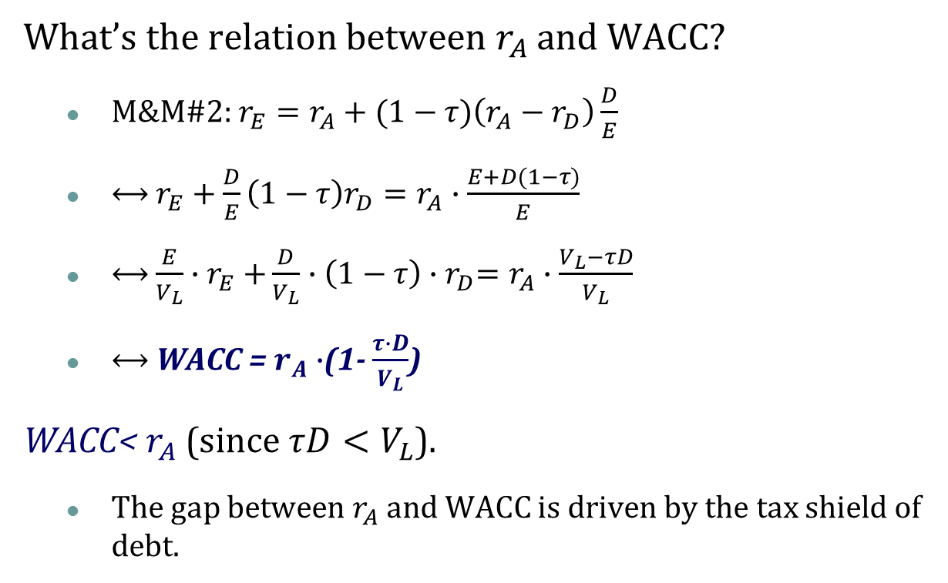

WACC and $R_{A}$
What’s the relation between $r_{A}$ and WACC?
M&M#2: $r_{E}=r_{A}+(1−τ)\left(r_{A}−r_{D}\right)\frac{D}{E}$
⟷ $r_{E}+\frac{D}{E}\left(1−τ\right)r_{D}=r_{A}∙\frac{E+D(1−τ)}{E}$
⟷ $\frac{E}{V_{L}}{∙r}_{E}+\frac{D}{V_{L}}∙\left(1−τ\right){∙r}_{D}=r_{A}$ $∙\frac{V_{L}−τD}{V_{L}}$
⟷ WACC = $r_{A}∙$(1- $\frac{τ∙D}{V_{L}}$)
WACC< $r_{A}$ (since $τD<V_{L}$).
The gap between $r_{A}$ and WACC is driven by the tax shield of debt.

Slide 22
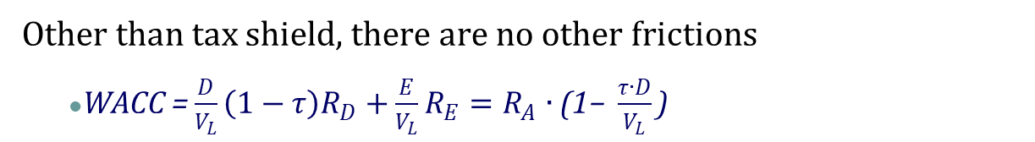




WACC and $R_{A}$
Other than tax shield, there are no other frictions
WACC = $\frac{D}{V_{L}}\left(1−τ\right)R_{D}+\frac{E}{V_{L}}R_{E}=R_{A}∙\text{(1− }\frac{τ∙D}{V_{L}}\text{)}$
Cost of Capital
$$R_{E}=R_{A}+\frac{D}{E}(1−τ)(R_{A}−R_{D})$$
$$R_{A}$$
$$R_{A}$$
$$WACC=R_{A}∙\text{(1− }\frac{τ∙D}{V_{L}}\text{)}$$
$$R_{D}$$
D/E

Slide 23





WACC and $R_{A}$
From “No Tax Shield” to “With Tax Shield”:
Cost of Capital
$$R_{E}=R_{A}+\frac{D}{E}(R_{A}−R_{D})$$
No Tax
$$R_{E}=R_{A}+\frac{D}{E}(1−τ)(R_{A}−R_{D})$$
With Tax
No Tax
$$R_{A}$$
$$WACC^{U}=R_{A}$$
$$WACC=R_{A}∙\text{(1− }\frac{τ∙D}{V_{L}}\text{)}$$
With Tax
$$R_{D}$$
D/E

Slide 24

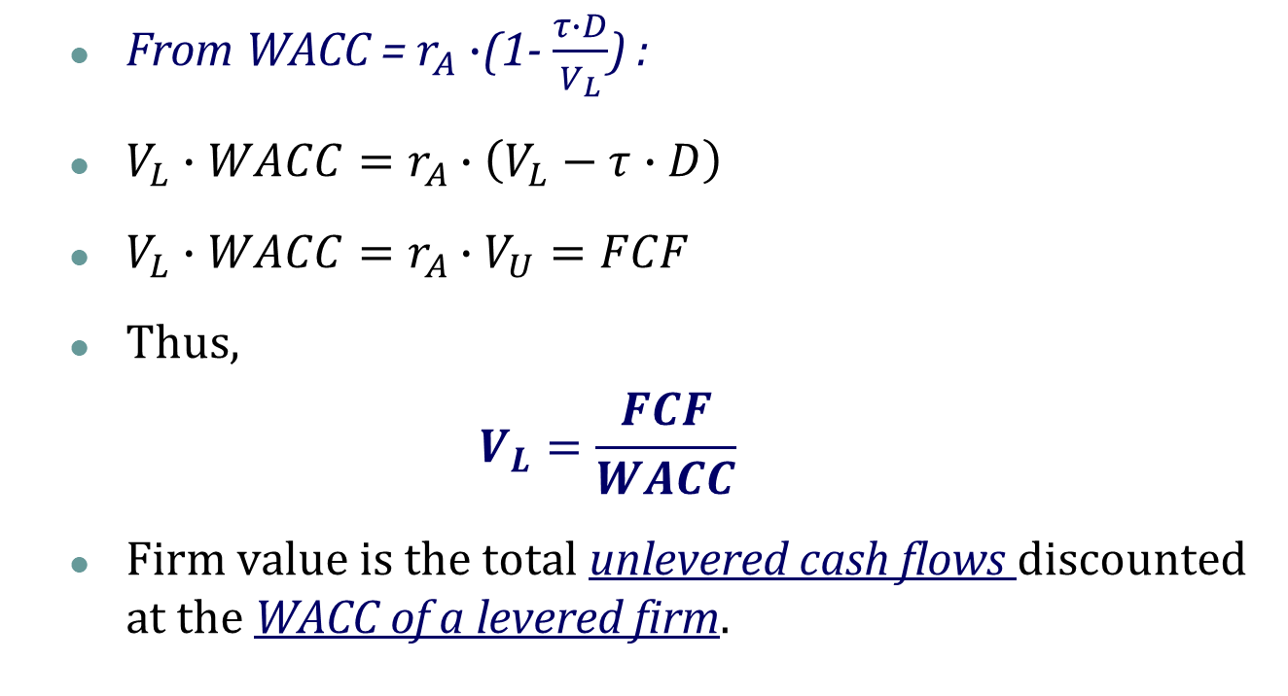
WACC and Firm Value
From WACC = $r_{A}∙$(1- $\frac{τ∙D}{V_{L}}$) :
$V_{L}∙WACC=r_{A}∙\left(V_{L}−τ∙D\right)$
$V_{L}∙WACC=r_{A}∙V_{U}=FCF$
Thus,
$$V_{L}=\frac{FCF}{WACC}$$
Firm value is the total unlevered cash flows discounted at the WACC of a levered firm.
Recall: $V_{U}=\frac{FCF}{r_{A}}$

Slide 25
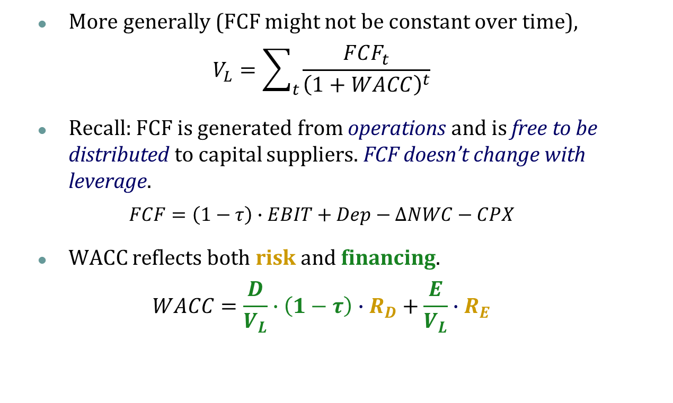
WACC and Firm Value
More generally (FCF might not be constant over time),
$$V_{L}=\sum_{t}{\frac{FCF_{t}}{{\left(1+WACC\right)}^{t}}}$$
Recall: FCF is generated from operations and is free to be distributed to capital suppliers. FCF doesn’t change with leverage.
$$FCF=\left(1−τ\right)∙EBIT+Dep−ΔNWC−CPX$$
WACC reflects both risk and financing.
$$WACC=\frac{D}{V_{L}}∙\left(1−τ\right)∙R_{D}+\frac{E}{V_{L}}∙R_{E}$$

Slide 26
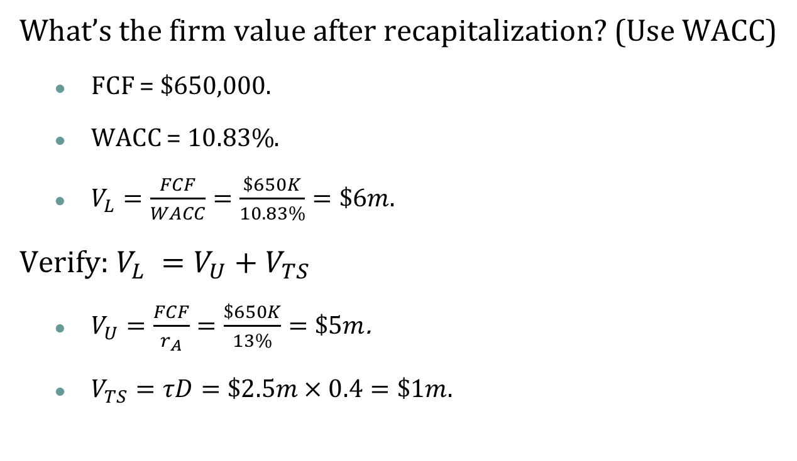
JELLYBEANS, INC.
Try it!
What’s the firm value after recapitalization? (Use WACC)
FCF = $650,000.
WACC = $10.83\%$.
$V_{L}=\frac{FCF}{WACC}=\frac{\$650K}{10.83\%}=\$6m$.
Verify: $V_{L} =V_{U}+V_{TS}$
$V_{U}=\frac{FCF}{r_{A}}=\frac{\$650K}{13\%}=\$5m$.
$V_{TS}=τD=\$2.5m×0.4=\$1m$.

Slide 27
Takeaways
I. Without any frictions
Capital structure is irrelevant as long as it does not affect the total cash flows generated by the assets
Return on equity increases with leverage, since debt increases the risk of equity.
WACC is the discount rate of firm’s cash flow (FCF) for finding firm value

Slide 28
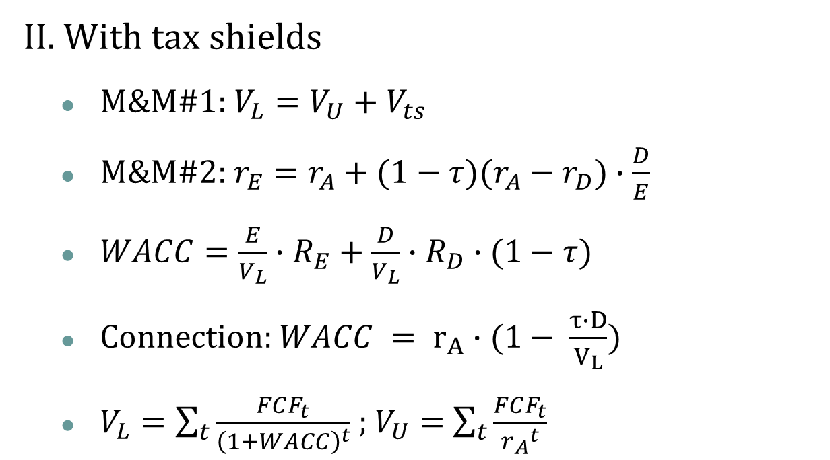
Takeaways
II. With tax shields
M&M#1: $V_{L}=V_{U}+V_{ts}$
M&M#2: $r_{E}=r_{A}+(1−τ)(r_{A}−r_{D})∙\frac{D}{E}$
$WACC=\frac{E}{V_{L}}∙R_{E}+\frac{D}{V_{L}}∙R_{D}∙(1−τ)$
Connection: $WACC = r_{A}∙(1− \frac{τ∙D}{V_{L}})$
$V_{L}=\sum_{t}{\frac{FCF_{t}}{{\left(1+WACC\right)}^{t}}}$ ; $V_{U}=$ $\sum_{t}{\frac{FCF_{t}}{{r_{A}}^{t}}}$

Slide 29
Exercise
Try it!
Ch16-25 MM with Taxes Dickson, Inc., has a debt-equity ratio of 2.3. The firm’s weighted average cost of capital is 10 percent and its pretax cost of debt is 6 percent. The tax rate is 24 percent.
a. What is the company’s cost of equity capital?
b. What is the company’s unlevered cost of equity capital?
c. What would the company’s weighted average cost of capital be if the firm’s debt-equity ratio were .75? What if it were 1.3?

Slide 30
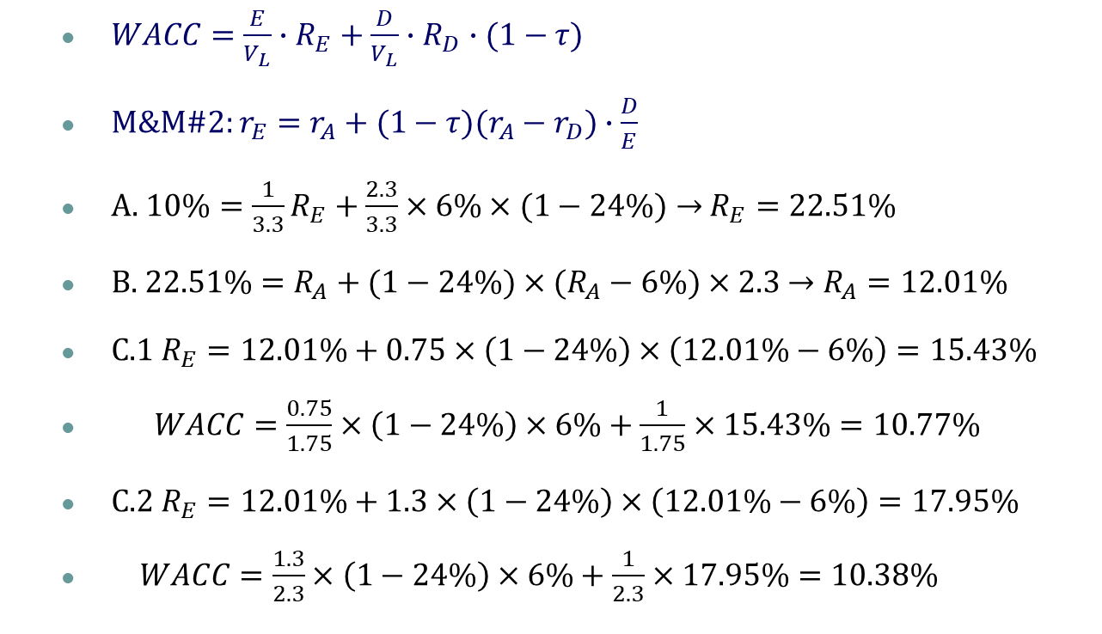
Exercise
Try it!
$WACC=\frac{E}{V_{L}}∙R_{E}+\frac{D}{V_{L}}∙R_{D}∙(1−τ)$
M&M#2: $r_{E}=r_{A}+(1−τ)(r_{A}−r_{D})∙\frac{D}{E}$
A. $10\%={\frac{1}{3.3}R}_{E}+\frac{2.3}{3.3}×6\%×(1−24\%)→$ $R_{E}=22.51\%$
B. $22.51\%=R_{A}+(1−24\%)×(R_{A}−6\%)×2.3$ $→$ $R_{A}=12.01\%$
C.1 $R_{E}=12.01\%+0.75×\left(1−24\%\right)×\left(12.01\%−6\%\right)=15.43\%$
$WACC=\frac{0.75}{1.75}×\left(1−24\%\right)×6\%+\frac{1}{1.75}×15.43\%=10.77\%$
C.2 $R_{E}=12.01\%+1.3×\left(1−24\%\right)×\left(12.01\%−6\%\right)=17.95\%$
$WACC=\frac{1.3}{2.3}×\left(1−24\%\right)×6\%+\frac{1}{2.3}×17.95\%=10.38\%$

